Slide 1
Simulation of Packet Traversal in 4G and 5G Network
Project Mentor – Prof. Neeraj Tyagi
Professor, CSE Department, MNNIT Allahabad

Slide 2
Team Members
Mrinal Varshney (20223156)
Mangal Gupta (20223141)
Dhiraj Kumar Jaiswal (20223515)
Kundan Kumar (20223133)

Slide 3
Motivation
Growing demand for low-latency, high-throughput, and service-differentiated mobile networks.
4G EPC lacks native support for network slicing and multi-UPF routing.
5G requires isolation of services such as VoIP, streaming, and general internet traffic.
Operators need flexible user-plane routing and policy-based traffic control for modern applications.
Understanding packet traversal is essential to analyze performance, QoS enforcement, and real network behavior.
Notes:
VoIP needs very low latency and minimum jitter
Streaming needs high throughput but can tolerate some buffering
General Internet browsing is best-effort and does not require strict QoS
If all traffic uses the same network path (as in 4G), congestion from one service affects the others.
5G isolates VoIP, streaming, and internet traffic into different slices to ensure each service gets the performance it requires without affecting others.

Slide 4
Overview
Simulated complete 4G/5G packet traversal, focusing on 5G’s advanced user-plane architecture.
Deployed a full 5G Core (Open5GS) including AMF, SMF, UPF, NRF, PCF, AUSF, UDM, and NSSF
Implemented three dedicated UPFs for Internet, VoIP, and Streaming traffic.
Configured network slicing.
Employed UERANSIM to emulate two gNBs and multiple UEs for realistic mobility and traffic testing.
Integrated real application servers (Asterisk VoIP and Nginx Media Server) to generate slice-specific traffic.
Validated PFCP signalling, GTP-U tunnelling, QoS enforcement (MBR) using Wireshark.
Used Grafana + Prometheus to monitor core and UPF performance metrics.

Slide 5
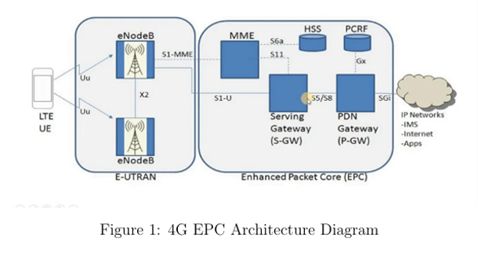
Fundamentals: 4G Packet Traversal
Traffic flows as:
UE → eNodeB → SGW → PGW → Internet
SGW + PGW anchor and route all user traffic.
Limited Policy Control
  No PFCP; only GTP-C controls bearer setup.
  Lacks dynamic routing, per-service paths, or slicing.
  All services (VoIP, streaming, browsing) share the same EPC core path.
Notes:
UE to eNB: The UE sends IP packets to the eNB over the radio interface (Uu).
eNB to S-GW: The eNB adds a GTP-U header, creating an S1 tunnel, and sends the encapsulated packets to the S-GW.
S-GW to P-GW: The S-GW removes the S1 tunnel header, adds its own GTP-U header, creating an S5 tunnel, and forwards the packets to the P-GW.
P-GW to Internet: The P-GW removes the S5 tunnel header and forwards the original IP packet to the internet.

Slide 6
Why 4G Fails to Support True Network Slicing ?
EPC uses a monolithic user-plane → one S-GW & P-GW for all services
No concept of SST/SD, no per-service logical networks
QoS based only on EPS bearers, limited flexibility & coarse-grained
No multi-UPF routing → cannot route traffic type
No service isolation → VoIP, streaming, IoT, web all mix in same routes to different gateways
Control/User Plane tightly coupled (before CUPS release)
CUPS (4G Release 14) still does not enable full slicing; no NSSF, no per-slice AMF/SMF equivalents

Slide 7
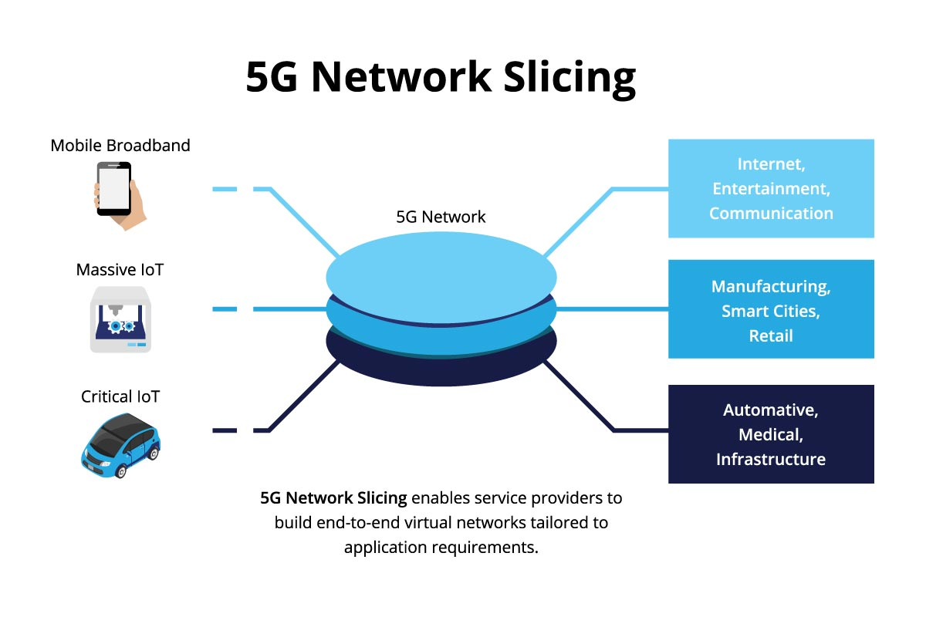
Network Slicing in 5G
5g network slicing enables multiple logical networks over the same physical network.
Each user is assigned a slice using (SST, SD)
Each slice maps to a specific SMF + UPF chain in our design (SD1 → UPF1, SD2 → UPF2, SD3 → UPF3).
Traffic isolation ensures independent QoS handling, routing paths, and rate limits.
Allows VoIP, streaming, and general internet to coexist without interfering.
Notes:
Slice/Service Type (SST)
Definition: An SST is an 8-bit field that identifies the expected behavior of a network slice in terms of its services and features.
Function: It broadly categorizes slices, such as for enhanced mobile broadband (eMBB), ultra-reliable low-latency communication (URLLC), or massive machine-type communication (mMTC).
Standardization: Some SST values are standardized by 3GPP to ensure global interoperability.
Slice Differentiator (SD)
Definition: A non-standardized, optional field that supplements the SST.
Function: It differentiates between multiple network slices that share the same SST. For example, two different slices for a specific type of online gaming could have the same SST but different SD values.
Purpose: It provides a way to create more granular network slices beyond the general categories defined by the SST.

Slide 8
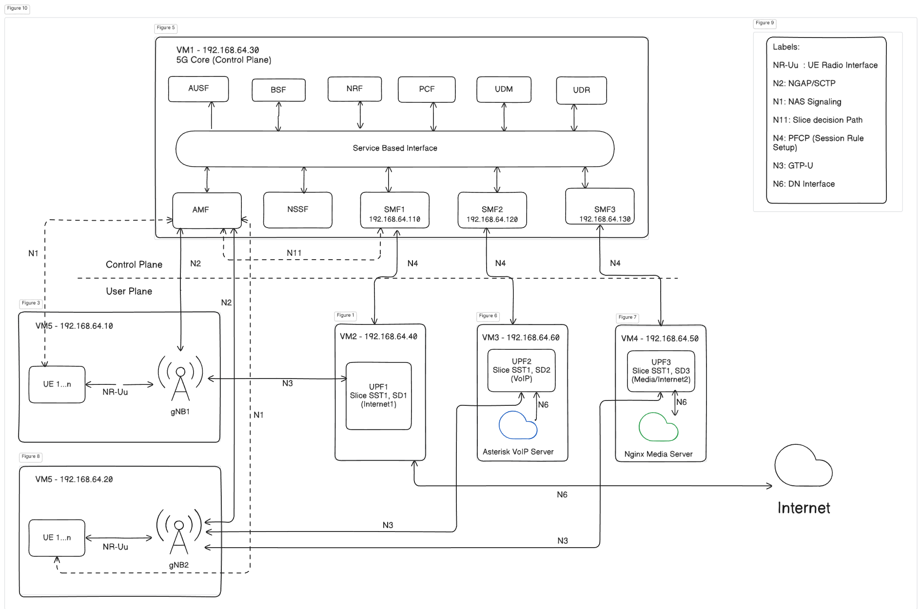
5G - Network Architecture
(Simulated)

Slide 9
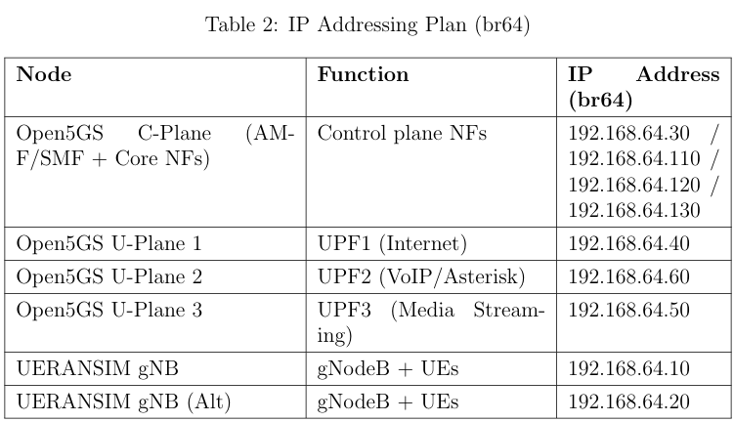
IP Addressing Plan and Transport Network
A dedicated LXD bridge (br64) provides a stable 5G transport network:

Slide 10
Network Slicing in Our 5G Deployment
Implemented SST = 1 with three Slice Differentiators: SD = 1, 2, 3
Each slice mapped to a dedicated SMF + dedicated UPF
UE assigned slice using IMSIs mapped to SST/SD
Each slice gets:
  its own DNN
  its own subnet
  its own traffic characteristics (latency / throughput constraints)

Slide 11
Slice Definitions
Slice 1 (SD=1): General Internet
  UPF1
  DNN: internet
  Subnet: 10.45.0.0/16
  Use-case: web browsing, general IP traffic
Slice 2 (SD=2): VoIP
  UPF2
  DNN: voip
  Subnet: 10.46.0.0/16
  Use-case: delay-sensitive, SIP/RTP flows
Slice 3 (SD=3): Streaming
  UPF3
  DNN: internet2
  Subnet: 10.47.0.0/16
  Use-case: buffered video download, throughput-intensive

Slide 12
PDU Session Establishment for Each Slice
UE sends Registration + PDU Session Establishment
AMF consults NSSF – determines slice (SD=1/2/3)
AMF selects correct SMF instance
SMF establishes PFCP association with respective UPF
UE receives IP from slice-specific subnet
Traffic routed: UE → gNB → correct UPF → DN

Slide 13
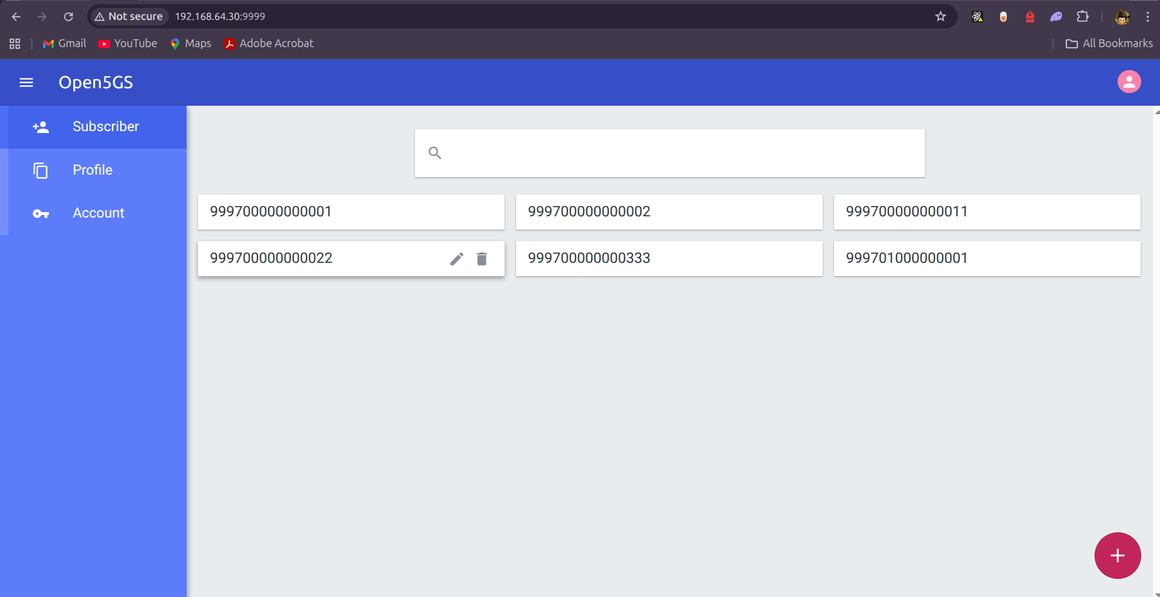
Open5gs WebUI

Slide 14
Tests & Analysis
Slice 1: General Internet (UPF1)
Test Conducted
  Standard internet access was verified using the following commands from the UE terminal, routing through the uesimtun0 interface:
  ping-I uesimtun0 google.com
Expected Behaviour
  Routing: Packet traversal is UE → gNB → UPF1 → Host NAT → Public Internet.
  Latency: Higher latency (≈ 50 − 100 ms) is acceptable due to the reliance on external network hops.
  Encapsulation: Traffic is encapsulated in GTP-U between the gNB and UPF1

Slide 15
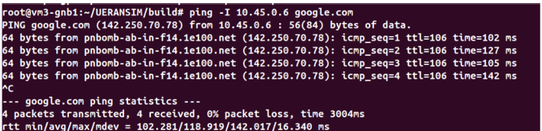

Slide 16
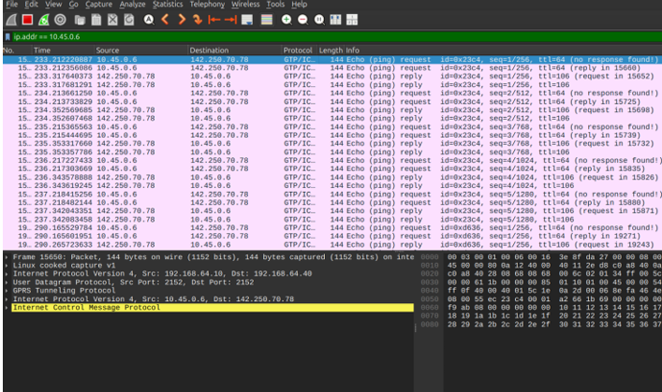

Slide 17
Slice 2: VoIP Traffic (UPF2)
Test Conducted
  A test sequence was executed to simulate SIP/VoIP traffic:
  UERANSIM UE registers with the local Asterisk server.
  A test SIP call is placed to initiate RTP traffic.
  Traffic is analyzed using sngrep or a client on the UPF2 machine.
Expected Behavior
  Routing (Local Breakout): Packet traversal is UE → gNB → UPF2 → Local SIP Server. The traffic avoids the central data network UERANSIM UE registers with the local Asterisk server.
  QoS: Extremely low Jitter and Latency are expected, validating the 5QI=1 priority level and the local breakout.
  Encapsulation: The RTP packets are decapsulated by UPF2 and sent as standard UDP packets to the local Asterisk server.

Slide 18
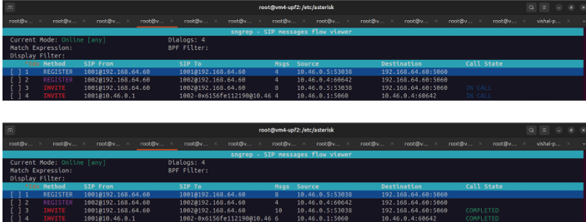
SIP Session Flow- sngrep output captured on the Asterisk server (UPF2 N6 interface) detailing the SIP signaling flow. The successful REGISTER messages and the progression of INVITE Dialog 4 to the ’IN CALL’ state conclusively prove that the dedicated VoIP Slice (5QI=1) is fully operational, establishing the local breakout path through UPF2 necessary for low-latency media.
Expected Behavior • Routing (Local Breakout): Packet traversal is UE → gNB → UPF2 → Local SIP Server. The traffic avoids the central data network. • QoS:Extremely low Jitter and Latency are expected, validating the 5QI=1 priority level and the local breakout. • Encapsulation: The RTP packets are decapsulated by UPF2 and sent as standard UDP packets to the local Asterisk server

Slide 19
Slice 3: Streaming Traffic (UPF3)
Test Executed
  A large video file was downloaded from the local Nginx streaming server 192.168.64.50 to the UE using the curl utility. The command was set to capture the exact transfer time and average download speed in Bytes per second (B/s)
Expected Behaviour
  Routing: Packet flow is UE → gNB → UPF3 → Local Nginx Server
  Policy Enforcement: The transfer rate should be limited close to the configured Downlink MBR of 10 Mbps (which translates to ≈ 1,250,000 B/s), thereby confirming the QER policy programmed via PFCP.

Slide 20
Throughput = 1,211,583 B/s ×8 bits/byte/1,000,000 ≈ 9.69 Mbps
This calculated throughput of 9.69 Mbps is within the expected tolerance (≈ 3% variance) of the configured 10 Mbps Downlink MBR.

Slide 21
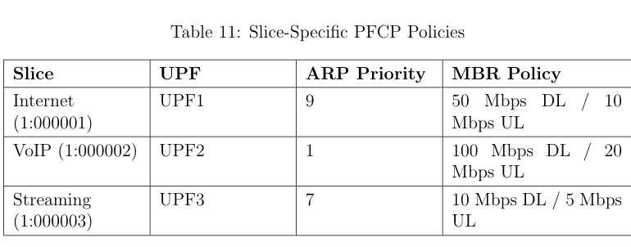
QoS Validation via High-Load Performance (iperf)
Test Conducted
  Two identical UDP streams, each targeting 100 Mbps, were sent from UEs belonging to the General Internet Slice (SD=0x1) and the VoIP Slice (SD=0x2) 42 to a test server (192.168.64.40). The performance metrics focused on Jitter and Packet Loss Rate (PLR).

Slide 22
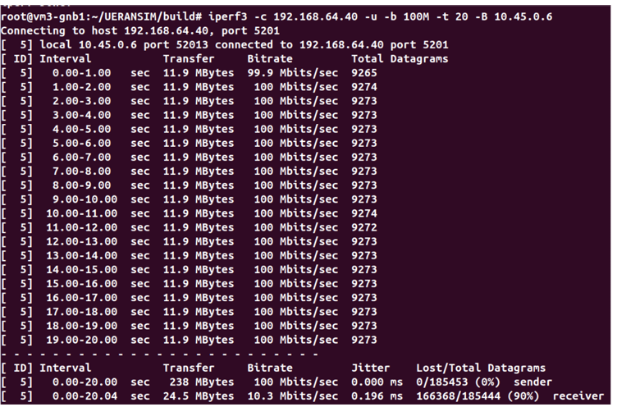

Slide 23
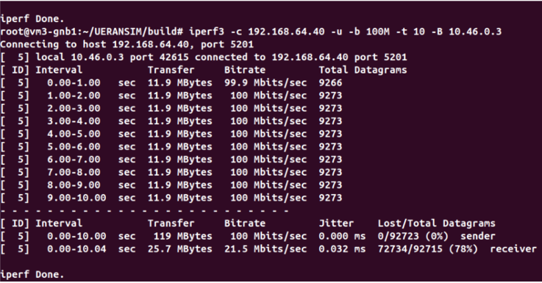

Slide 24
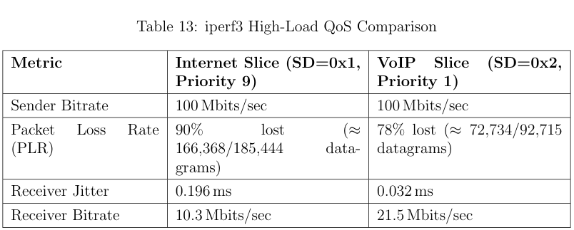

Slide 25
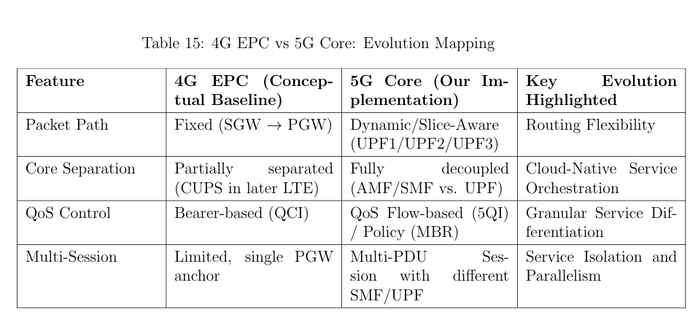
Correlation of 5G with 4G Packet Traversal (EPC)

Slide 26
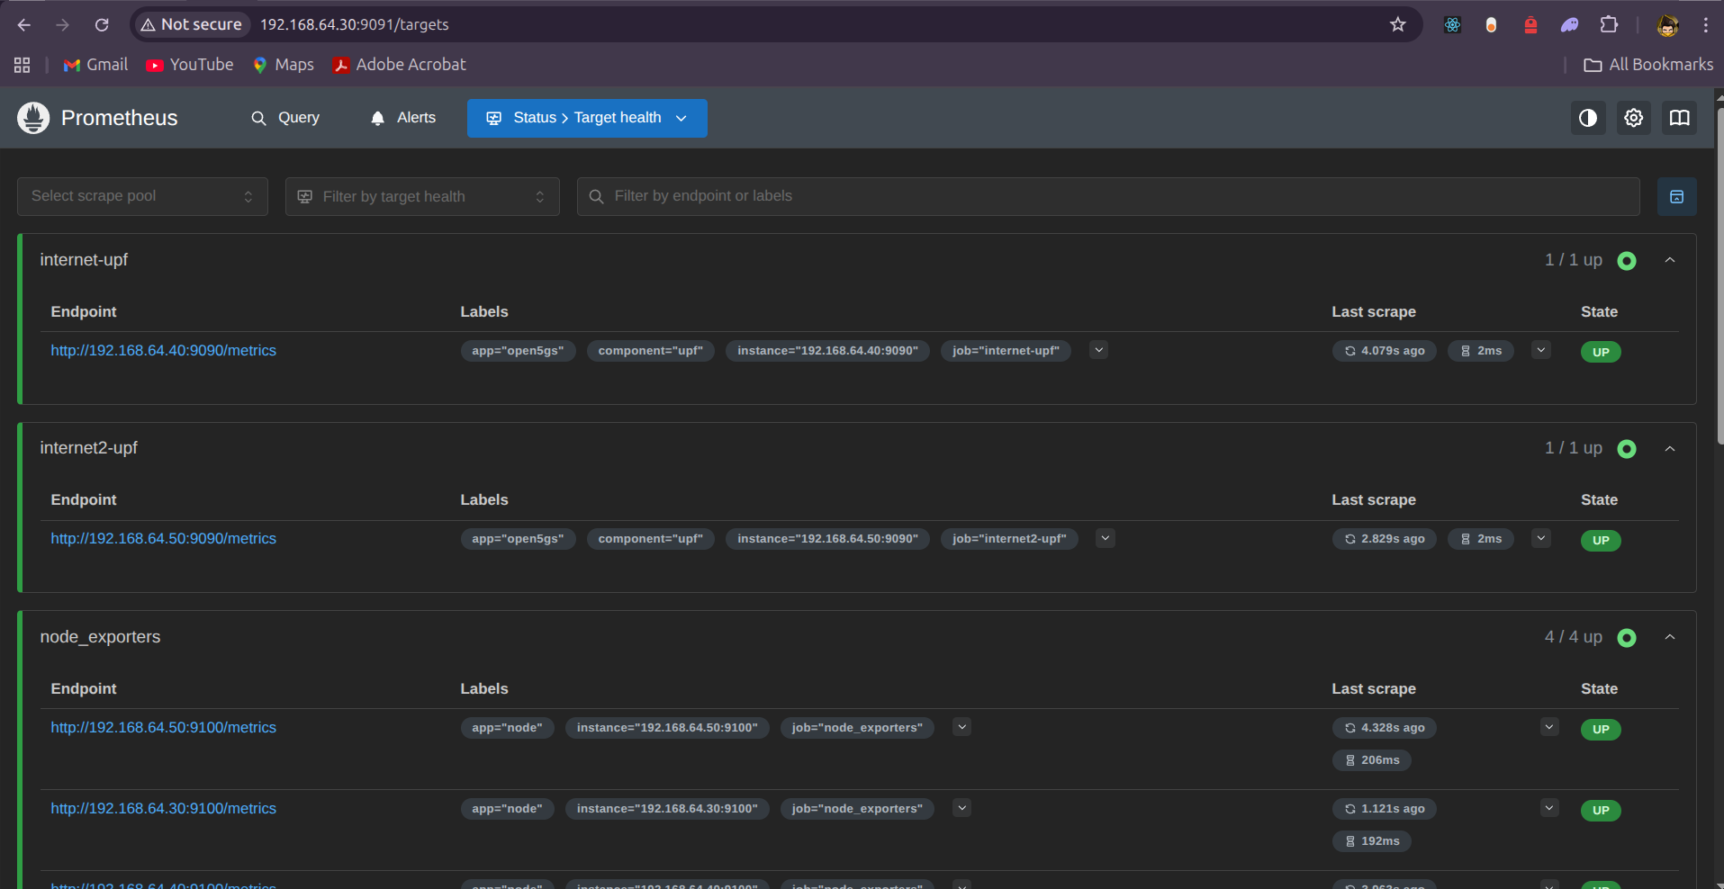
Prometheus Logs

Slide 27
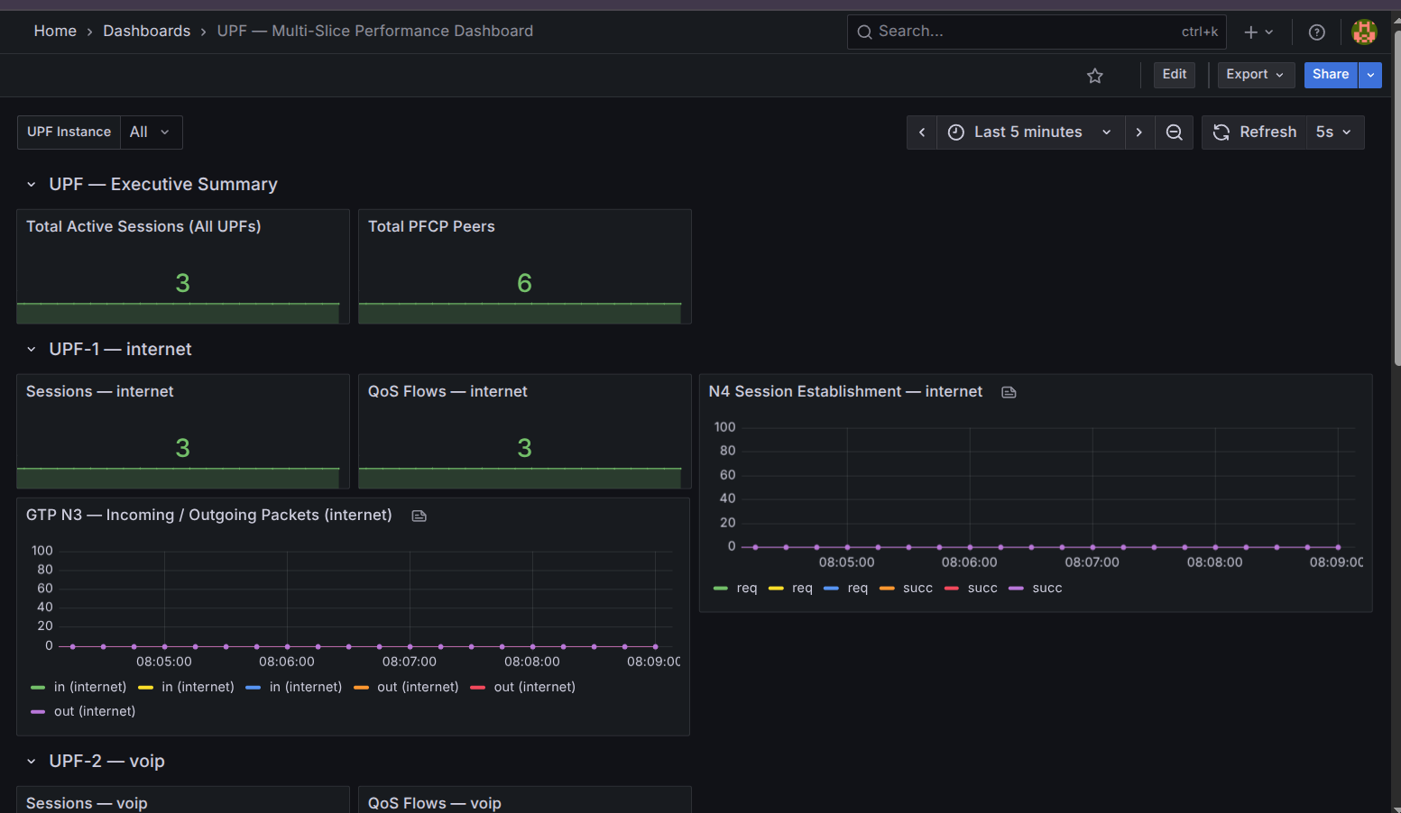
Grafana Monitoring

Slide 28
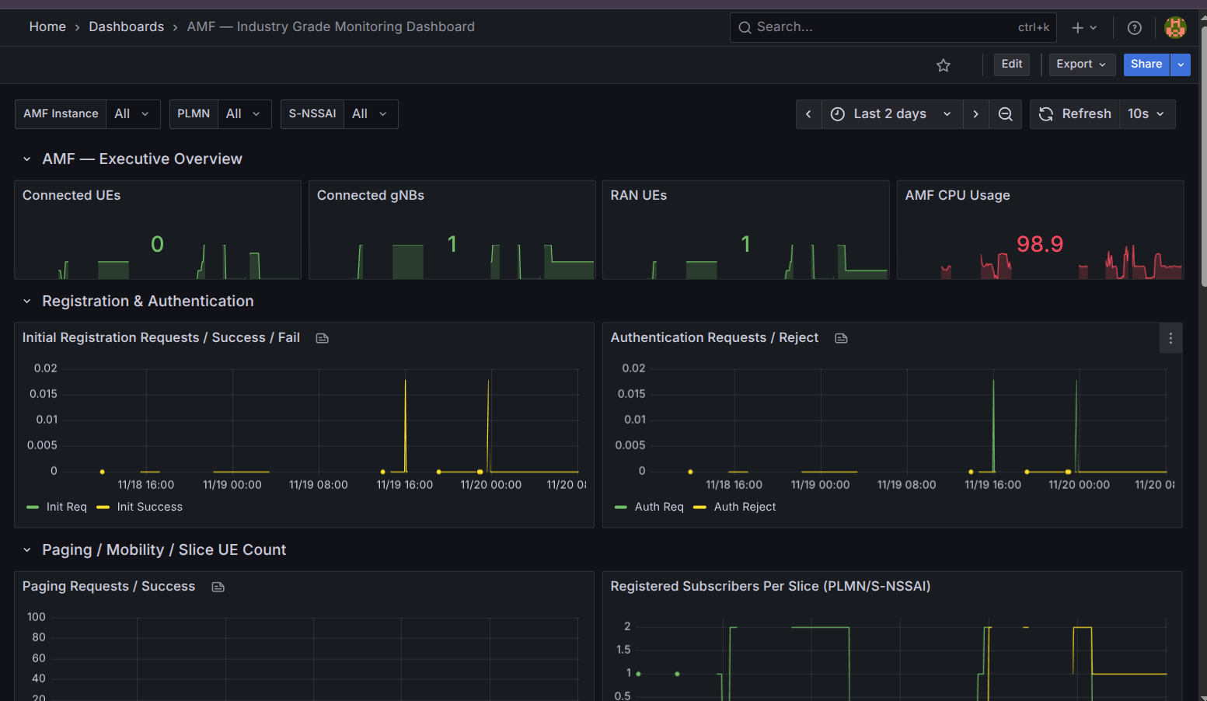

Slide 29
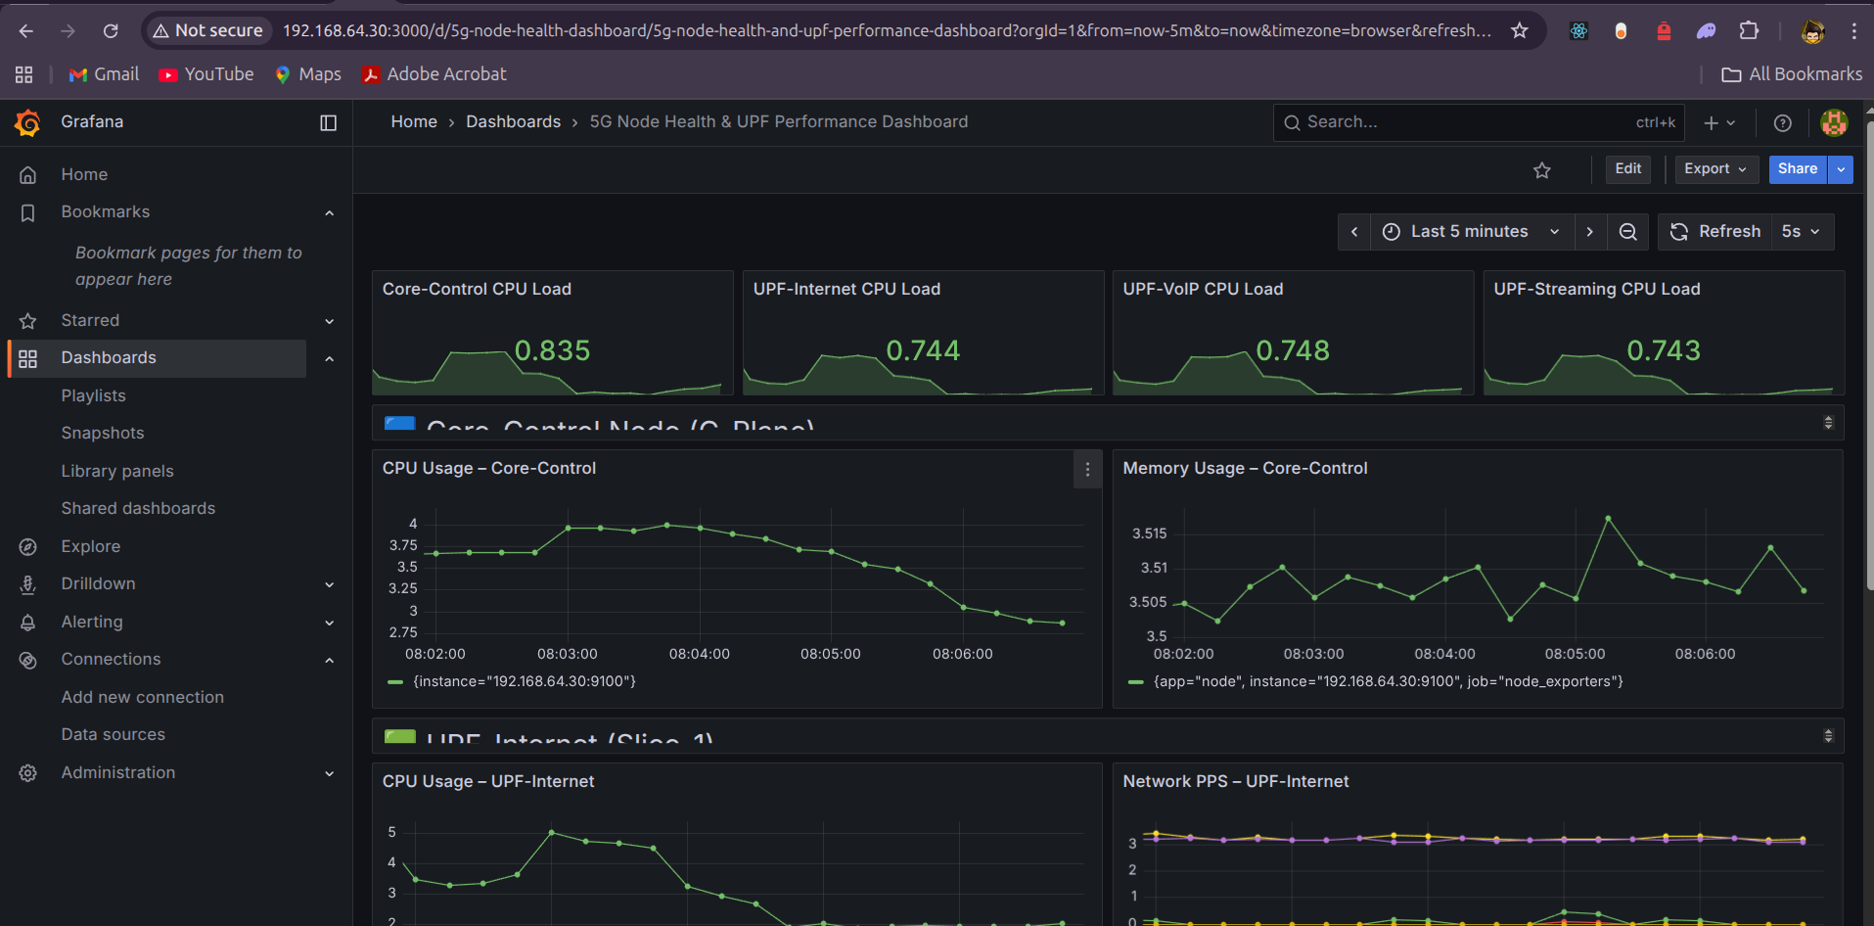

Slide 30
Key Achievements and Validation
Complete Deployment of 5G SBA Control Plane
Multi-UPF, Multi-Slice Routing Validation:
Functional QoS Policy Enforcement
Low-Latency Performance for VoIP Slice
Local Breakout Validation
End-to-End Packet Verification - : Wireshark traces confirmed correct operation of:– GTP-U (N3)– PFCP (N4)– NAS/NGAP signaling.

Slide 31
Future Scope
Future enhancements that can extend this work include:
  Full 4G EPC + 5G Interworking: Deploy MME, SGW, PGW in Open5GS and test 4G–5G mobility using the N26 interface. 48
  Dynamic Network Slice Orchestration: Implement external orchestration to dynamically create/scale SMF/UPF instances and modify NSSAI in real time.
  SRv6 Implementation: Replace GTP-U tunneling with SRv6 for N3/N9 interfaces to measure changes in policy enforcement and latency.
  AI-Driven Slice Optimization: Use ML models to predict slice load and automatically scale UPFs or reassign UE slice mapping, introducing automation to SBA

Slide 32
Thank You

